Slide 1
Whole Network Descriptives
Molly Copeland
PhD Candidate
Duke Sociology
Social Networks & Health, 2018
Notes:
Special acknowledgment to Valente’s Social Networks & Health textbook & Moody’s social networks seminar lectures (backbone for materials here), Brea Perry for excellent lecture yesterday describing many of the measures and mechanisms for ego-networks that have counterparts

Slide 2
“Whole” Network Descriptives
Sociocentric
Still consider sampling and network boundary
Notes:
“whole” in quotes because generally know entire the network of possible relations; same sampling and boundary issues discussed in the data collection lecture; overlap with ego-network measures, many have a sociocentric counterpart: main difference is here we generally have data, such as a survey response, on the alters as well as egos

Slide 3
Overview
Centrality
Connectivity & Cohesion
Roles
Notes:
Different frames for organizing how we think about network descriptives;
- Could think micro/meso/macro: microprocesses that help to generate networks, meso-features of sub-groups within network, macro features of entire networks;
- Here: starting with a more conceptual framework, if you’re used to analyses on individuals, translating that to network descriptives; or thinking about how we identify important actors in a network, how would we measure that

Slide 4
Overview
Centrality
Individual nodes
Centralization: Whole Networks
Structural Holes
Connectivity & Cohesion
Roles
Notes:
Mostly review, establish foundation for some of you, serve as a reminder for most of you of some of the options you might have forgot about; so hope that we can have a more interactive lecture style, so questions, suggestions encouraged, especially because my subfield is adolescents & mental health, know we have people in the room studying wide array of topics, so helpful if you bring up questions or great resources in your field
Centrality: individuals, networks, structural holes

Slide 5
Centrality: Individual Nodes
How can we distinguish “important” actors?
Centrality:
Who is at the ‘center’ of the network?
…but what is meant by ‘center’ gets complicated

Slide 6
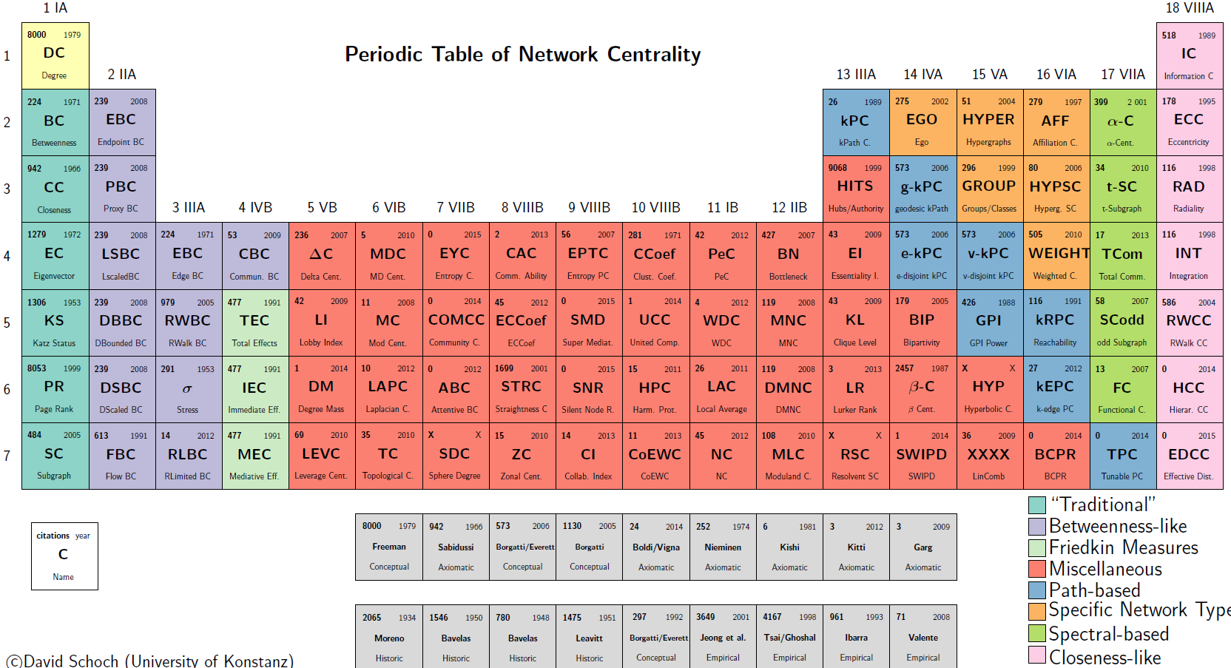
Notes:
h/t David Schoch organized this visual of just how many centrality measures there are; most convey slightly different information more/less appropriate for what you’re trying to measure;
Given this breadth: focus today on the main categories, intuition behind them

Slide 7
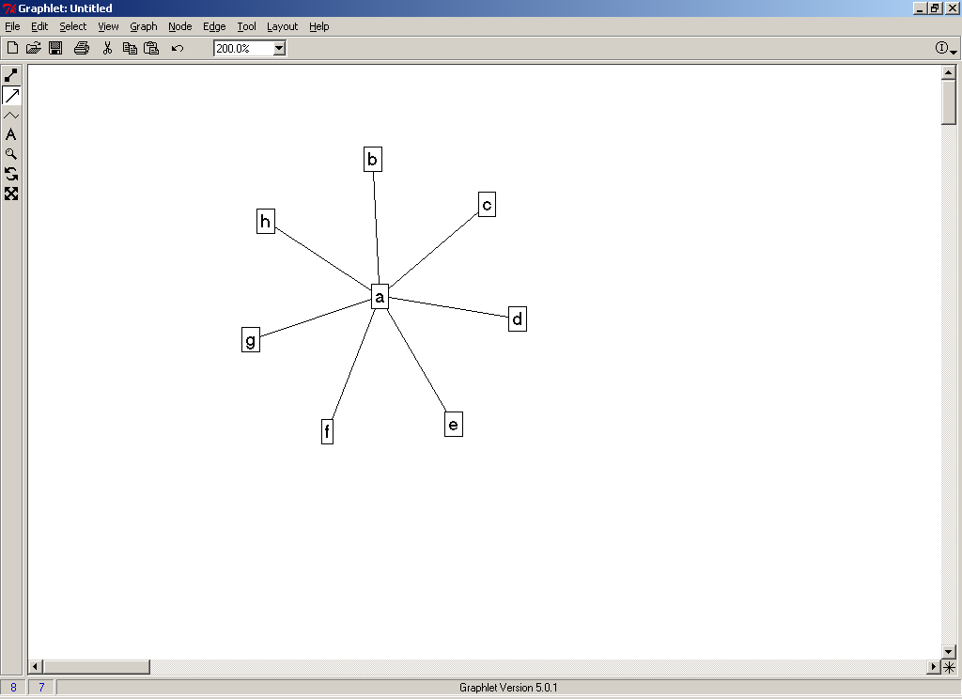
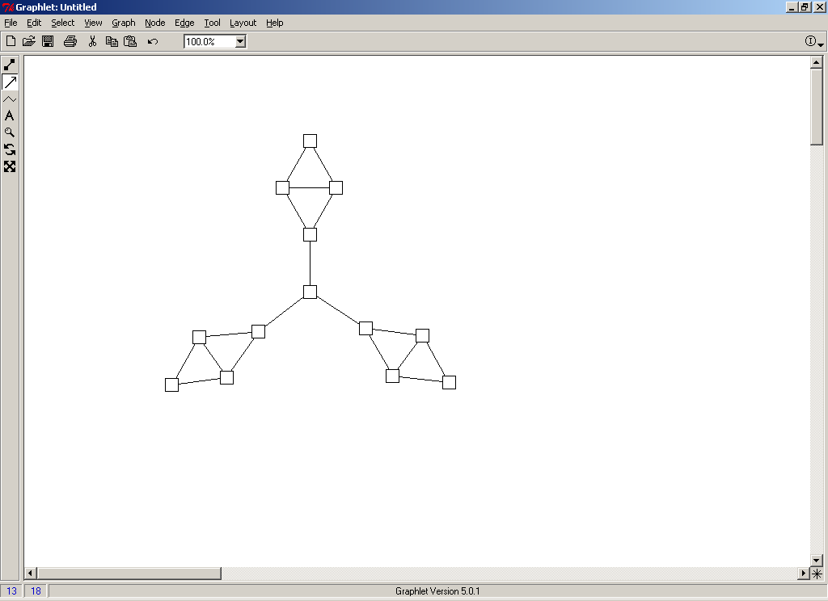
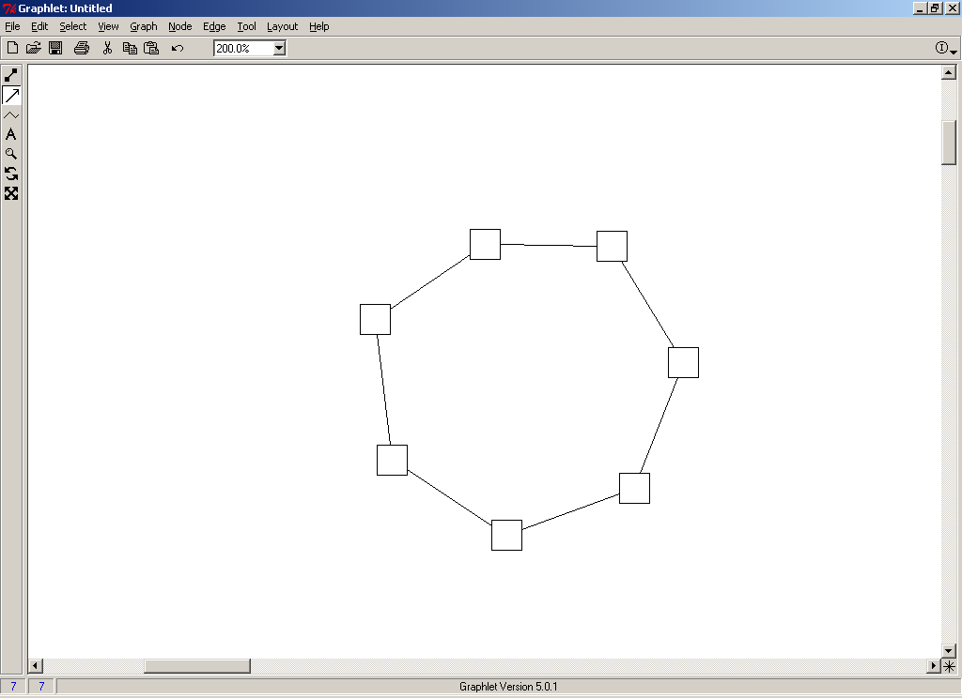
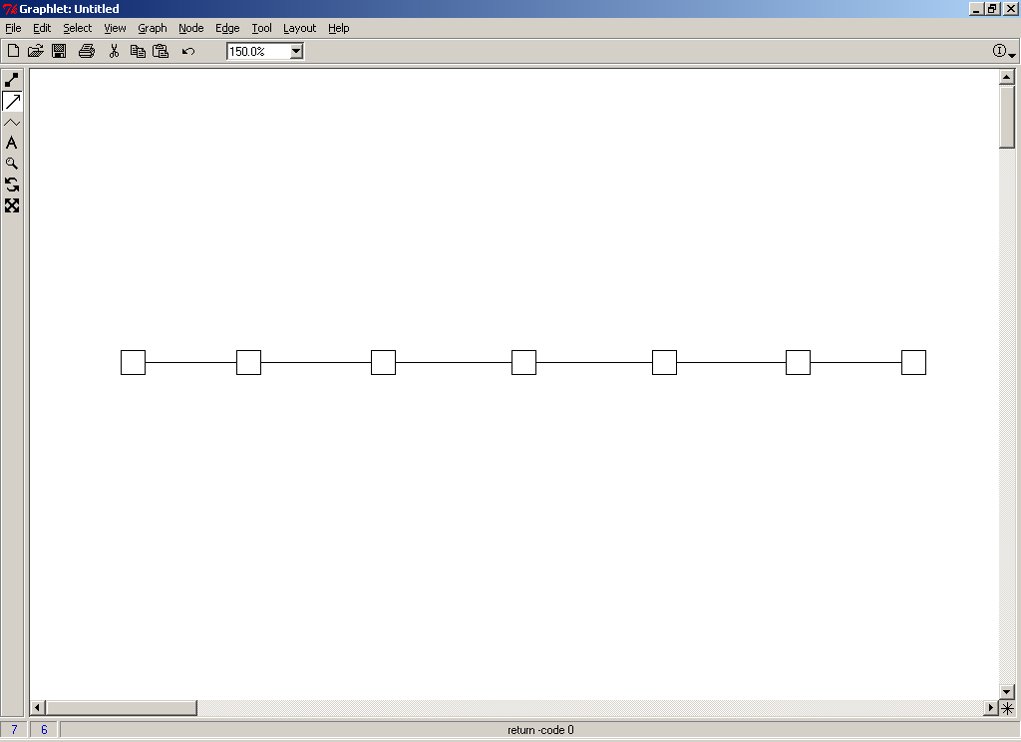
Centrality
How can we distinguish “important” actors?
Notes:
Centrality complicated by different ways networks can be structured
- Very clear way to determine who is central in graph on left, but harder to apply the same principle to determine who is central in graph on right or choose between two central actors in middle graph

Slide 8
Centrality
Freeman’s (1979) criteria:
Calculated on individuals
Normalized by network size to compare across networks
Derive network-level centralization counterpart
Notes:
Freeman popularized 3 most common broad types of centrality: degree, betweenness, closeness in 1979 paper, which outlines criteria for a centrality measure; most literature has focused on #1 of these 3
Ex: can calculate degree of each node (a vs. b), can calculate the normalized degree, then degree distribution of the network (will see how in a min)

Slide 9
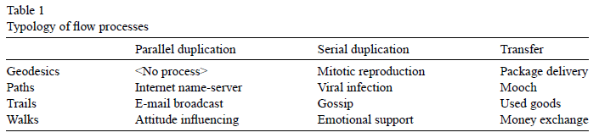
Centrality
Most useful measurement depends in part on type of network flow
Borgatti 2005
Notes:
As discussed yesterday, theoretical mechanism underpinning your RQ and process is key (whether networks as pipes or positions)
From Borgatti 2005, where geodesic – shortest path, path – sequence with no edge OR node repeated; trail – sequence with no edge repeated; walk – unrestricted; duplicated to share multiple edges at the same time, sequentially, or one piece directly transferred
Ex: Imagine package delivery: one item moving sequentially through a network by the shortest path to a specific destination (Amazon warehouse → local UPS → my house); compare to gossip: might not move by the shortest path, can be shared via multiple ties at once;

Slide 10
“Add Health” Example
Notes:
Ex: Running example to get a feel for these measures with the faux AddHealth dataset; one school, limited to 7th & 8th graders (not show gender or race or grade, keep it simple as possible to see role of centrality measures); subset of data using in the descriptives lab
See arrowheads showing descriptive data; about 35 nodes, representing students and friendship nominations

Slide 11
Centrality
How can we distinguish “important” actors?
Centrality measurement approaches:
Degrees
Closeness
Betweenness
Information & Power
Notes:
- Different common ways of measuring centrality; MANY more than these 4
- Before examining each in turn, one more conceptual step back to think about network flow processes

Slide 12
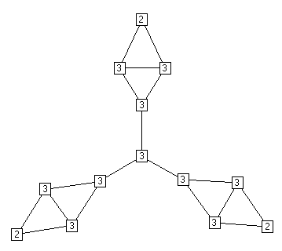
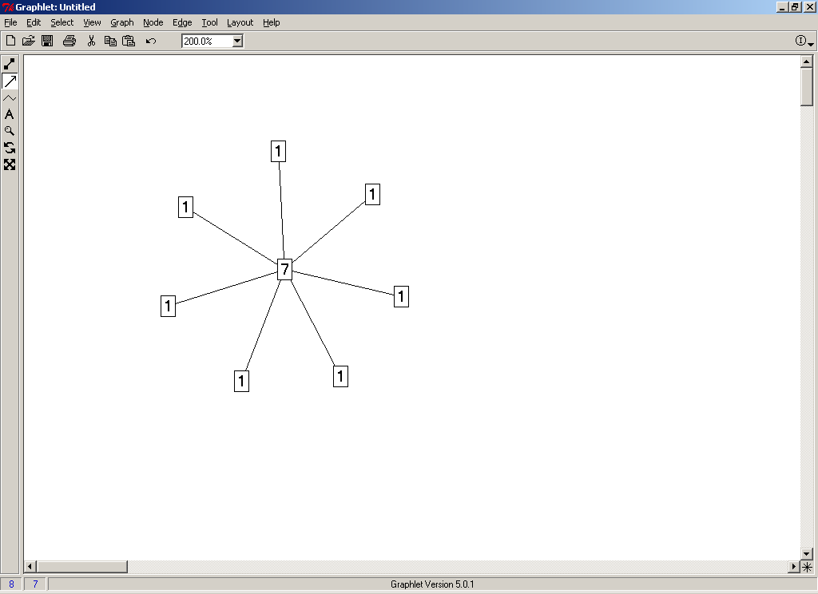
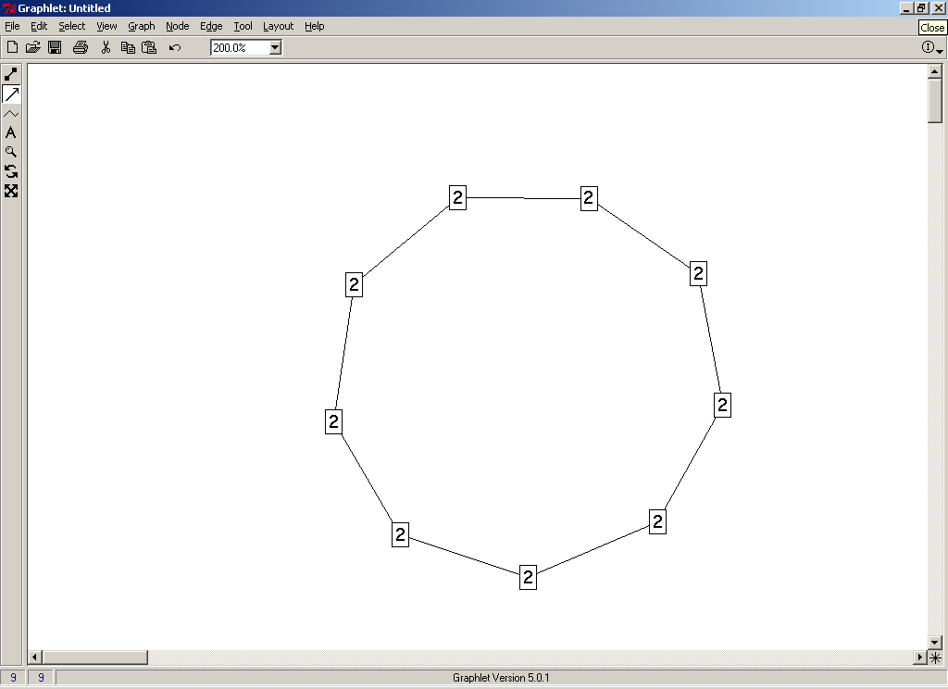
Centrality
Degree Centrality – number of ties
Undirected
Notes:
Many different types of notation for degrees, often normalized (over N-1) because that’s the maximum total possible – rare to normalize depending on your subfield (degree is interpretable, usually not the endpoint of our analysis); often calculated, then used as a variable in regression
Sensitive to instrument: prompt a certain number or truncate

Slide 13
“Add Health” Example: Degree
Notes:
Size by degree; some with one degree, some popular folks with 15

Slide 14
Centrality
Degree Centrality:
Directed
In-degrees
Out-degrees
Isolates
Notes:
With directed data, further distinguish between sent and received ties (can your network conceptually be directed, as in friendship noms vs. co-attendance at a meeting); note that should balance for whole network, but not necessarily for individuals
- Isolates as special case appearing excluded from network flow (higher risk for exclusion processes, protected from transmission)
Why might degree centrality matter? considering adolescent friendships – in-degrees as popularity (maybe suggesting influential peers), out-degrees as expansiveness, or aspirational ties to high status peers; can think of mechanisms for how popularity/expansiveness might matter: isolates might have less social support, popular might have more disease exposure or opinion leaders (as Brea said, more isn’t always better if you don’t know more of what)

Slide 15
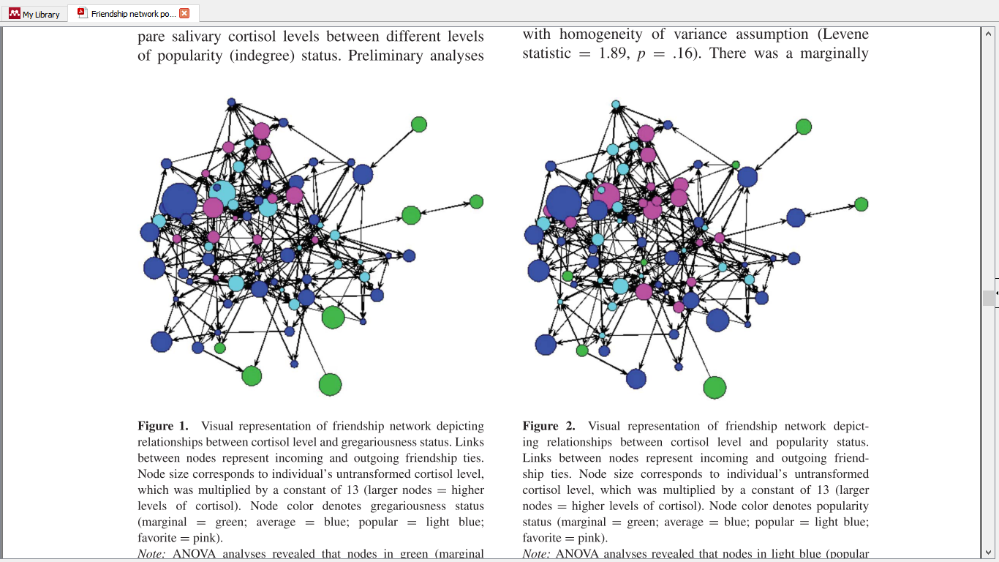
Centrality
Kornienko et al. 2013:
Test salivary cortisol (indicator of stress) on in-degrees, out-degrees, and ego-network density. They find significantly higher cortisol for lower out-degrees and a protective effect of medium popularity.

Slide 16
Centrality
Degree Centrality:
Directed
In-degrees
Out-degrees
Isolates
…But…
Notes:
But there’s always a but

Slide 17
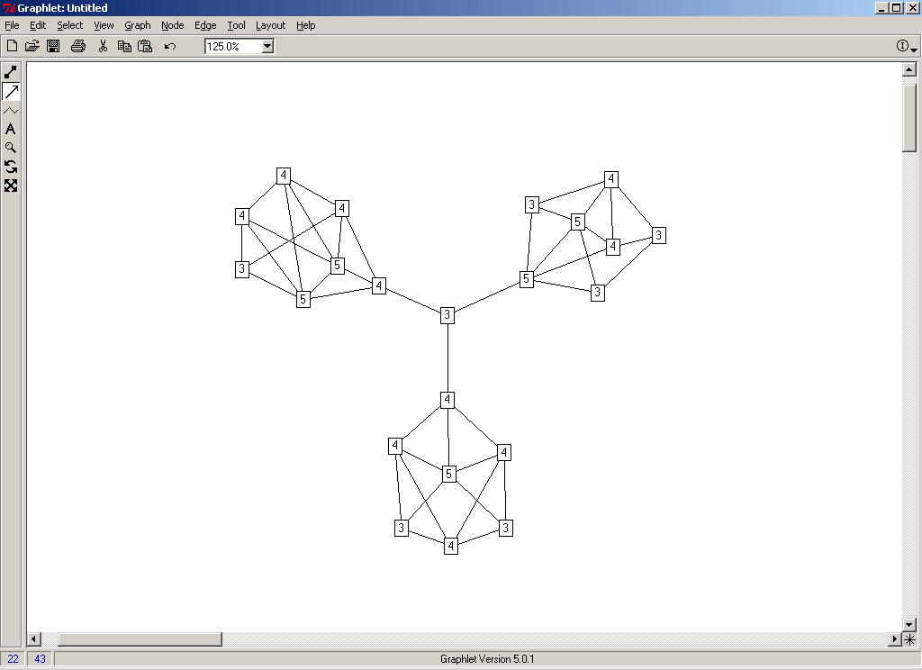
Centrality
Degree Centrality – local measure only:
Can be deceiving
Less appropriate for non-local questions
Notes:
- Because only measure each individual’s ties, not capturing larger structural patterns in the network (here, central actor bridging different sub-groups in the network looks less important than others with redundant connections within the subgroup)
- For questions that conceptually need to consider larger network structure, need a measure that takes that into account; transmission across sub-groups, connectedness across or within entire network

Slide 18
“Add Health” Example: In-degree
Notes:
2 in-degree, but different structural positions in the network; (can imagine same conditions for other degrees); question might be satisfied by considering local structure, but perhaps want to think more about individuals’ positions given the broader patterns observed in the network:

Slide 19
Centrality
Closeness: Actors considered important if less distance to all other actors in the network
inverse distance of each actor to every other
Geodesic distance – shortest path between 2 actors
Measurable within a connected graph or component where each node is reachable
Notes:
Note: not digging deep into math (mostly just push a button now) but it’s in there if you want to refer back; include some health examples if you want to see it in action, but not going to go too in depth given the diversity of topics in the room
Distance = geodesic distance – shortest path between 2 actors; if every actor in graph connected by at least one path, then we call it a component, and the graph is connected.

Slide 20
Centrality
Closeness
Inverse of the sum of distances from actor to all other actors
Normalized by graph size to range 0-1
Notes:
Closeness = inverse of sum of distances from actor i to all other actors; standardized to 0-1 range by graph size (g=#nodes)

Slide 21
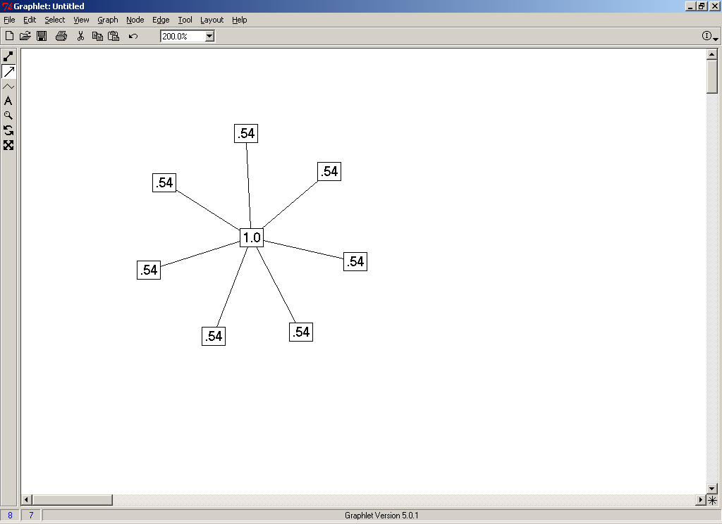
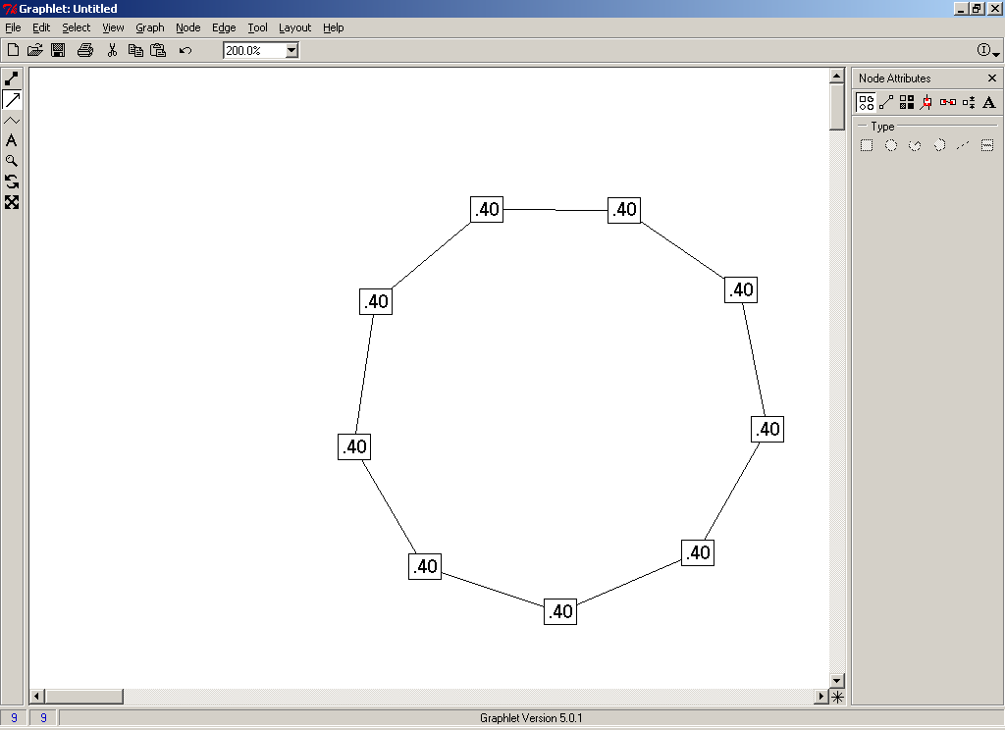
Closeness Centrality in the examples
Distance Closeness normalized
0 1 1 1 1 1 1 1 .143 1.00
1 0 2 2 2 2 2 2 .077 .538
1 2 0 2 2 2 2 2 .077 .538
1 2 2 0 2 2 2 2 .077 .538
1 2 2 2 0 2 2 2 .077 .538
1 2 2 2 2 0 2 2 .077 .538
1 2 2 2 2 2 0 2 .077 .538
1 2 2 2 2 2 2 0 .077 .538
Distance Closeness normalized
0 1 2 3 4 4 3 2 1 .050 .400
1 0 1 2 3 4 4 3 2 .050 .400
2 1 0 1 2 3 4 4 3 .050 .400
3 2 1 0 1 2 3 4 4 .050 .400
4 3 2 1 0 1 2 3 4 .050 .400
4 4 3 2 1 0 1 2 3 .050 .400
3 4 4 3 2 1 0 1 2 .050 .400
2 3 4 4 3 2 1 0 1 .050 .400
1 2 3 4 4 3 2 1 0 .050 .400
Notes:
Consider these toy mini-graphs: if undirected, see distance to other nodes in matrix, inverse of sum, then normalized to compare across graphs; different kind of structural information comparing across graphs compared to degree

Slide 22
Notes:
See closeness not that different from degree, smaller range of variation; plot degree vs. closeness; closeness in statnet, so those with only in-degs (pendants, too cool for school) have closeness of 0
Plot closeness by degree for our little toy graph: see similar, but struggles with those with out-degree=0

Slide 23
Centrality
Closeness
Can be directed – (in-closeness and out-closeness)
…But:
Non-linear distortion from taking inverse
Different non-infinity solutions for disconnected nodes
Often calculated as reverse distance
Notes:
Just like degree, direction of the flow might matter (someone who reaches many other might not be reachable in ways that matter, depending on nature of flow); Sometimes called directed closeness (instead of in & out)
Usually isolates treated as infinitely distant – sometimes substitute N (net size) or D + 1 (longest distance + 1)
For ex: statnet calculates in traditional social networks way with the inverse, so higher value = more close to other nodes in the net, but igraph doesn’t inverse, so higher closeness values = more distance (further)

Slide 24
Centrality
Betweenness
Actor considered important if controls information flow or bridges relatively disconnected portions of the network
Counts number of paths for actor j where j is on the shortest path between actors i and k
Notes:
Again, shortest path = geodesic (Where gjk = the number of geodesics connecting jk, and gjk(ni) = the number that actor i is on)
Strategic structural position beyond volume: who is a central bridge? For Freeman: gate-keepers

Slide 25
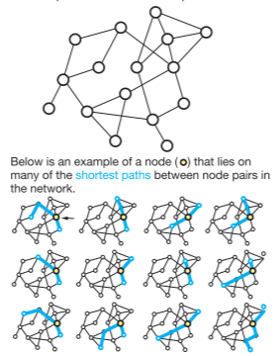
Centrality
Betweenness - number of paths for actor j where j is on the shortest path between actors i and k
Landon et al. 2012 JAMA, network contexts of physicians sharing patients (bipartite) find specialists have greater betweenness in rural region than urban
Notes:
High betweenness for connectors here (higher values = more times bridging other nodes, on the shortest geodesic); Landon has great visuals and explanation and speaks to physician networks if relevant to your work

Slide 26
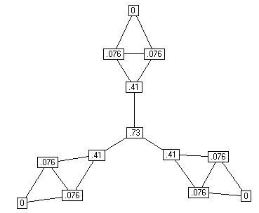
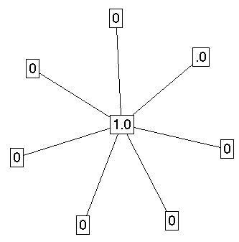
Centrality
Betweenness - number of paths for actor j where j is on the shortest path between actors i and k
Notes:
High betweenness for connectors here (higher values = more times bridging other nodes, on the shortest geodesic); Landon has great visuals and explanation and speaks to physician networks if relevant to your work

Slide 27
“Add Health” Example: Betweenness
Notes:
See differences from degree: important nodes connecting others

Slide 28
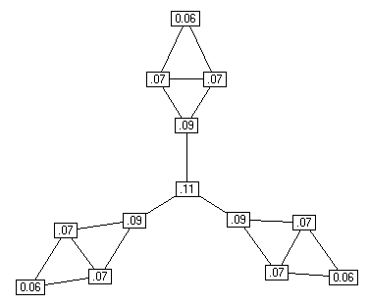
Centrality
Information Centrality
Like betweenness, but not restricted to geodesics; information can probably flow through paths other than geodesics
Betweenness Information Centrality
Notes:
Betweenness likely problematically restrictive: a lot of times information or whatever is flowing in the network (peer influence, flu) can spread by more than just the shortest path

Slide 29
Centrality: Comparing Measures
Low Degree/High Betweenness High Degree/Low Betweenness (few ties crucial for network flow) (many redundant ties)
Notes:
In small example network, see relatively low degree and high betweenness – few ties but crucial for network flow

Slide 30
In-degree
Betweenness
Notes:
Sized by degree vs. in-degree, see some popular students with redundant ties (not important bridgers), and some semi-popular kids with important bridging roles;

Slide 31
“Add Health” Example: Comparing Centrality
ID Degree Indegree Betw. Close.
1 6 4 0.50 0.28
2 4 3 28.00 0.20
3 6 1 22.47 0.35
4 6 6 0 0
5 11 3 38.17 0.37
6 11 2 51.50 0.40
7 13 7 78.95 0.39
8 9 2 120.7 0.47
9 5 2 14.67 0.35
10 5 2 15.33 0.34
Degree Indegree Betw. Close.
Degree -- 0.77 0.71 0.65
Indegree 0.77 -- 0.53 0.25
Betw. 0.71 0.53 -- 0.54
Close. 0.65 0.25 0.54 --
Notes:
See related, but not equivalent; some expansive, not v popular kids; others with redundant ties, or high bridging even though not most popular
In fact, see correlations between measures in our toy example

Slide 32
Centrality: Individual Nodes – Comparing Measures
Low correlations probably tell you something interesting:
Low
Degree
Low
Closeness
Low
Betweenness
High Degree
Embedded in cluster that is far from the rest of the network
Ego's connections are redundant - communication bypasses him/her
High Closeness
Key player tied to important important/active alters
Probably multiple paths in the network, ego is near many actors, but so are many others
High Betweenness
Ego's few ties are crucial for network flow
Very rare. Would mean ego monopolizes the ties from a small # of actors to many others.

Slide 33
Centrality
Power- actors are important if tied to other important actors
Bonacich Power Centrality (prestige) – actors tied to other important actors
Eigenvector centrality – similar to Bonacich, but without β, and symmetric (only undirected data)
Notes:
Formula:
αλπηα is a scaling vector, which is set to normalize the score.
βετα - weight the centrality of people ego is tied to: small value = local structure (same as degree as nears 0), larger value = weight to global structure (radius, or reach, of power); positive = higher centrality tied to other central people, negative = higher centrality tied to others who are not central
R is the adjacency matrix (can be valued)
I is the identity matrix (1s down the diagonal)
1 is a matrix of all ones.

Slide 34
“Add Health” Example: Bonacich Power Centrality
β = .5 β = -.5
Notes:
Beta as tuning: boost or penalty if alters’ are connected to others – imagine being connected to well-connected others as a higher score (more power/influence), or as a penalty (more powerful if connected to others with fewer connections)

Slide 35
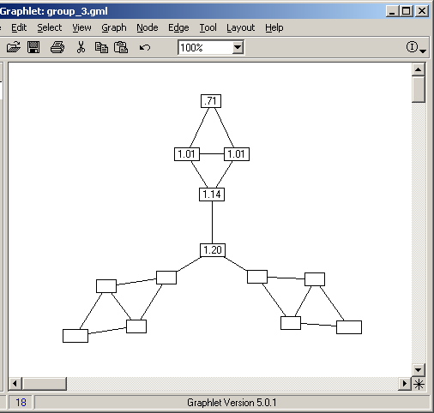

Centrality
Bonacich Power Centrality:
β = .35 β = -.35
Notes:
Beta as tuning: boost or penalty if alters’ are connected to others

Slide 36
Many More Measures
Peer Influence based measures (Friedkin and others). Based on the assumed network autocorrelation model of peer influence; variant of the eigenvector centrality measures
Fragmentation centrality – Borgatti’s Key Player - nodes are central if they can easily break up a network
Removal Centrality – effect on the rest of the (graph for any given statistic) with the removal of a given node; system-contribution of a particular actor

Slide 37
Many More Measures
Peer Influence based measures
Fragmentation centrality
Removal Centrality
Multiple measures in analysis
Ennett et al. 2006: higher betweenness, indegree, reach, Bonacich Power significantly associated with higher alcohol use for 15 year olds
But…Multicollinearity (don’t forget theory!)
Notes:
Can use in combination, but multicollinearity is concern, so best to be choosy based on theory

Slide 38
Centrality in the Network
Rather than considering important individual actors, describing characteristics of the overall network
To what extent are the links or is the ‘power’ of a network concentrated in a few nodes, versus spread throughout the network?
Degree Distributions
Centralization
Density
Notes:
Characteristics of entire collected sociocentric network that are corollaries of the measures used for individual nodes (Freeman’s definition, want indvl and net measure)

Slide 39
Whole Network Centrality
Degree Distribution – frequency distribution of degree values of actors
A simple random graph will have a Poisson degree distribution, so variation from that suggest non-random processes
Notes:
Translating individual actors degrees to whole network measures:

Slide 40
Whole Network Centrality
Degree Distribution – frequency distribution of degree values of actors
Notes:
Usually see power/gamma distribution

Slide 41
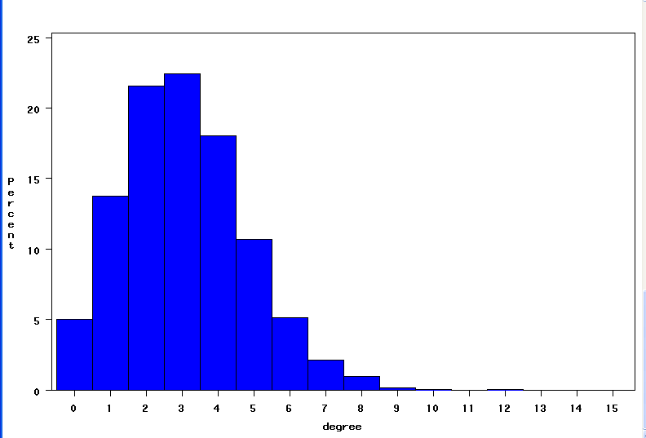
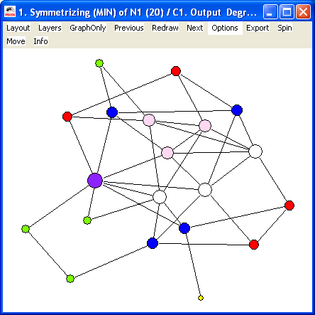
Whole Network Centrality
Typical social network degree distribution

Slide 42
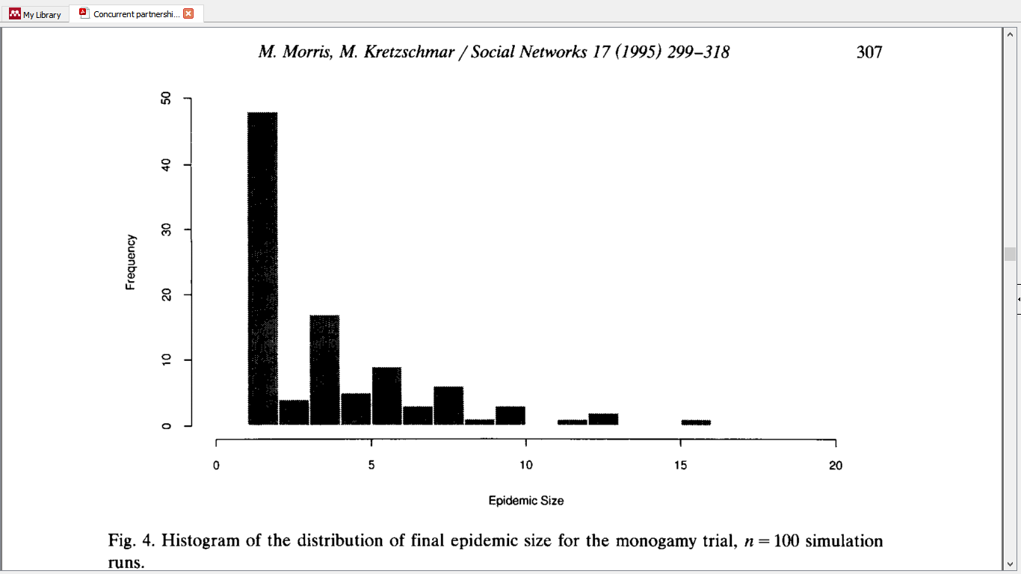
Notes:
Morris & Kretzchmar’s classic: simulating HIV, considering monogamy in degree distribution (in 100 simulations, most only add 1 infected partner, max is 16, under 1% of simulated pop)

Slide 43
Whole Network Centrality
Centralization – extent to which centrality is concentrated in one/few actors; dispersion of centrality in graph as a whole (Freeman centralization)
Notes:
Star: Freeman centralization of 1, Circle: 0; based on degree
Wasserman & Faust – std dev of centrality measures; beyond degree (indegree centlztn, betweeness centralization, etc.)

Slide 44
Whole Network Centrality
Density – volume of relations in network - number of ties relative to the number of possible ties
Density = .09
Notes:
Saw this as key feature of egonets;
Density typically low if friendship relation, hierarchies

Slide 45
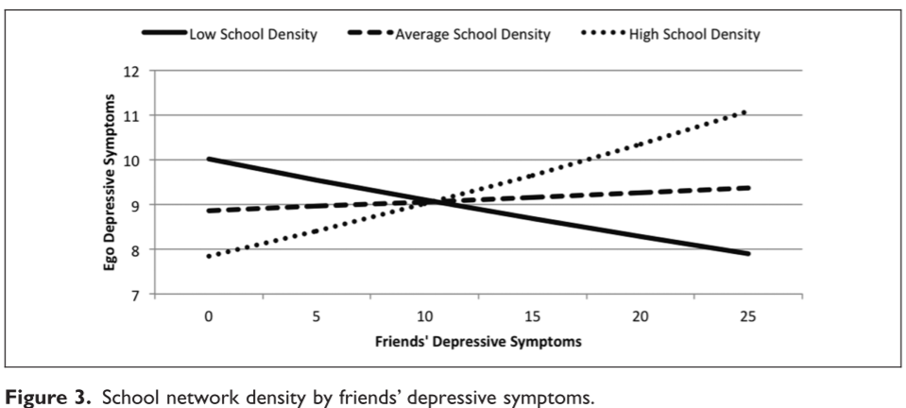
Whole Network Centrality
Density – volume of relations in network - number of ties relative to the number of possible ties
Guan & Kamo 2016: contagion of friends’ depression varies with density of high school network (Add Health)
Notes:
Saw this as key feature of egonets;
Density typically low if friendship relation, hierarchies; use density to define special subgroups, like cliques (discuss in a minute)
Often see interactions between size and density

Slide 46
Describing Networks
Beyond centrality, consider structural arrangements in combination with attributes:
Similarity of attributes: typically Homophily – tendency for actors with similar attributes to be more likely to be connected
Assortativity - assortative/disassortative mixing
Individual attributes: gender, same firm
Structural attributes: same degree
Descriptive, not distinguishing selection/influence
Notes:
Discussed Homophily, but can think about it on the network level as assortativity; many more processes that account for similarity
For example: often see aspects of assortative and disassortative mixing in adolescent networks: popular kids tend to befriend other popular kids, but unpopular kids also more likely to nominate popular kids
Also depends on RQ: assortative gender homophily in friendships, dissassortative gender mixing in heterosexual sexual partner networks

Slide 47
Homophily & Assortativity
Notes:
In our toy example: see sorting by grade and gender (green = 7th, blue = 8th), males = triangles, females = squares

Slide 48
Connecting Measures to Mechanisms: Structural Holes
Structural holes: absence of ties between alters
Bridging structural holes: connecting people who otherwise would not be connected; social capital, access to resources
Redundancy (ties that connect ego to alters already connected to) introduces constraint
Power, brokerage by controlling info or resource by bridging structural holes (Simmel’s tertius gaudens)
(Burt 1992)
Notes:
Links back to Granovetter’s SoWT; matter for negotiation, innovation; or maybe bridges have better social skills because it’s hard to be a bridge

Slide 49
Connecting Measures to Mechanisms: Structural Holes
Bridging structural holes
Redundancy & constraint
Power & brokerage
Cornwell 2009: Spanning structural holes significantly positive associated with physical and mental health for older adults (ego-network data, NSHAP)
Notes:
Very little health & networks work leveraged structural holes in sociocentric settings (mostly business/management)

Slide 50
Connecting Measures to Mechanisms: Structural Holes
4 related network features:
Effective Size – (size – redundancy) – average degree of ego network without counting alters’ ties to ego
Efficiency – (effective size / observed size)
Constraint – room to exploit structural holes or negotiate; extent to which network alters are connected with each other (direct/indirect, proportion of network ‘time & energy)
Hierarchy – for Burt/structural holes, many measures of hierarchy generally – extent to which constraint is concentrated in one actor
Notes:
These measures and the idea of structural holes are important because indicate another way/tradition (Burt’s) of thinking about power or benefiting from network structure

Slide 51
Effective Size – (size – redundancy)
Efficiency – (effective size / observed size)
Constraint –(direct/indirect, proportion of network ‘time & energy)
Hierarchy – extent to which constraint is concentrated in one actor

Slide 52
Describing Networks
What are the structural arrangements or characteristics of networks underlying actors’ power, influence, or centrality?

Slide 53
Overview
Centrality
Connectivity & Cohesion
Triads & Transitivity
Clustering
Structural Cohesion
Roles
Notes:
Thinking about patterns of connections between actors, or the network structure beyond centrality

Slide 54
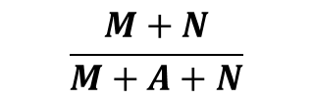
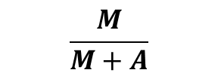
Connectivity & Cohesion: Local Processes
Dyadic – Reciprocity
Dyad Census: MAN
Mutual
Asymmetric
Null
Proportion Symmetric:
Proportion reciprocal of non-null
$$\frac{M+N}{M+A+N}$$
$$\frac{M}{M+A}$$
Notes:
- Often consider as MAN distribution; proportion dyads that are mutual, out of all, or non-null

Slide 55
Network Sub-Structure: Triad Census & UMAN
(0)
(1)
(2)
(3)
(4)
(5)
(6)
003
012
102
111D
201
210
300
021D
111U
120D
021U
030T
120U
021C
030C
120C
Notes:
Like dyad census, can have triad census: Configuration of possible triads (16 total) w directed edges;
Interested in triads in sociology or for health mechanisms because 3 actors smallest unit that starts to introduce interesting in social processes (Holland & Leinhardt, Granovetter, Simmel)
Often consider as UMAN distribution – uniform graph distribution of mutual, asymmetric, and null ties (numbers in triad names mean), then use letter to distinguish types within that configuration of edges (Up, down, transitive, cycle – note the meaning of a cycle)
Like dyad census, can compare observed distribution of triads in your data to expected in uniform graph (one piece at the heart of ERGMS & Siena, control for these processes, like friend of friend being a friend, to net that out to measure processes of interest, like peer selection & influence of smoking)

Slide 56
Connectivity & Cohesion: Local Processes
Characterize non-random social patterns in triad connections with the triad census – counting observed triads of each possible type
Transitivity
If i → j and j → k, then i → k
With directed ties, observe transitive, intransitive, vacuous triads
Notes:
Directed triad closure
Important feature of triads is transitivity: more likely to be connected to alters’ alters than a random node
Granovetter’s ‘forbidden triad’ – likely know someone your friend knows

Slide 57
Network Sub-Structure: Triad Census
(0)
(1)
(2)
(3)
(4)
(5)
(6)
003
012
102
111D
201
210
300
021D
111U
120D
Intransitive
Transitive
021U
030T
120U
Mixed
021C
030C
120C
Notes:
Transitive & intransitive triads in directed census; blend of mutual and asymmetric ties introduce mixed triads

Slide 58
Connectivity & Cohesion: Local Processes
Social Balance Theory: like nodes, edges can have attributes, too:
my friend’s friend is my friend,
my friend’s enemy is my enemy,
my enemy’s friend is my enemy,
my enemy’s enemy is my friend Heider (1958)
-
+
-
+
-
-
-
+
-
Notes:
Extend transitivity in social relations to balance theory: positive and negative relations reflect balance at heart of transitivity: see likely know alters’ alters’, but if valued like a positive relationship like friendship, friend of a friend is a friend; but if your friend doesn’t get along with person C, you likely don’t get along with them (friends’ enemy is my enemy); or your enemy’s friends are likely your enemies, weirder when think about enemy’s enemy is friend depending on setting (might just be another enemy, or ambivalent, but can think of game theoretic setting when working together against common enemy or something like that)

Slide 59
Dyad census:
M A N
67 506
Triad Census:
003 012 102 021D 021U 021C
4084 1536 519 82 43 88
111D 111U 030T 030C
41 69 9 0
201 120D 120U 120C
13 13 15 6
210 300
14 3
Transitive Triads: 141
Transitive Clustering Coefficient: 0.36
Notes:
Dyads & triads in toy example, like most: mostly null (need to normalize by network size if going to compare)
Like most social networks, very rare to have completely asymmetric cycles;
Even with few nodes in small subsampled networks, 141 transitive triads (see how this gets computationally intensive)
Characterize transitivity in a normalized way w clustering coefficient (weak version): proportion of triads where if i → j and j → k, also i → k

Slide 60
Connectivity & Cohesion: Clustering
Getting less local:
How can we describe the connective or cohesive nature of a network overall?
Notes:
“scale free” because description of the system (uneven distribution of connectivity) doesn’t change with scope/scale/magnification of system; popularized by Barabasi, see hints of it in Colorado Springs network, otherwise pure scale-free rare in social networks (timing, scheduling, other limitations that impose scale limits)

Slide 61
Connectivity & Cohesion: Clustering
Scale-free networks:
Globally: networks with highly skewed degree distributions
Locally: high-degree nodes act as hubs
Preferential Attachment
Creates ‘scale-free’ pattern that suggests implications for diffusion
Ex: disease transmission via high-degree ‘hubs’
Notes:
“scale free” because description of the system (uneven distribution of connectivity) doesn’t change with scope/scale/magnification of system; popularized by Barabasi, see hints of it in Colorado Springs network, otherwise pure scale-free rare in social networks (timing, scheduling, other limitations that impose scale limits)

Slide 62
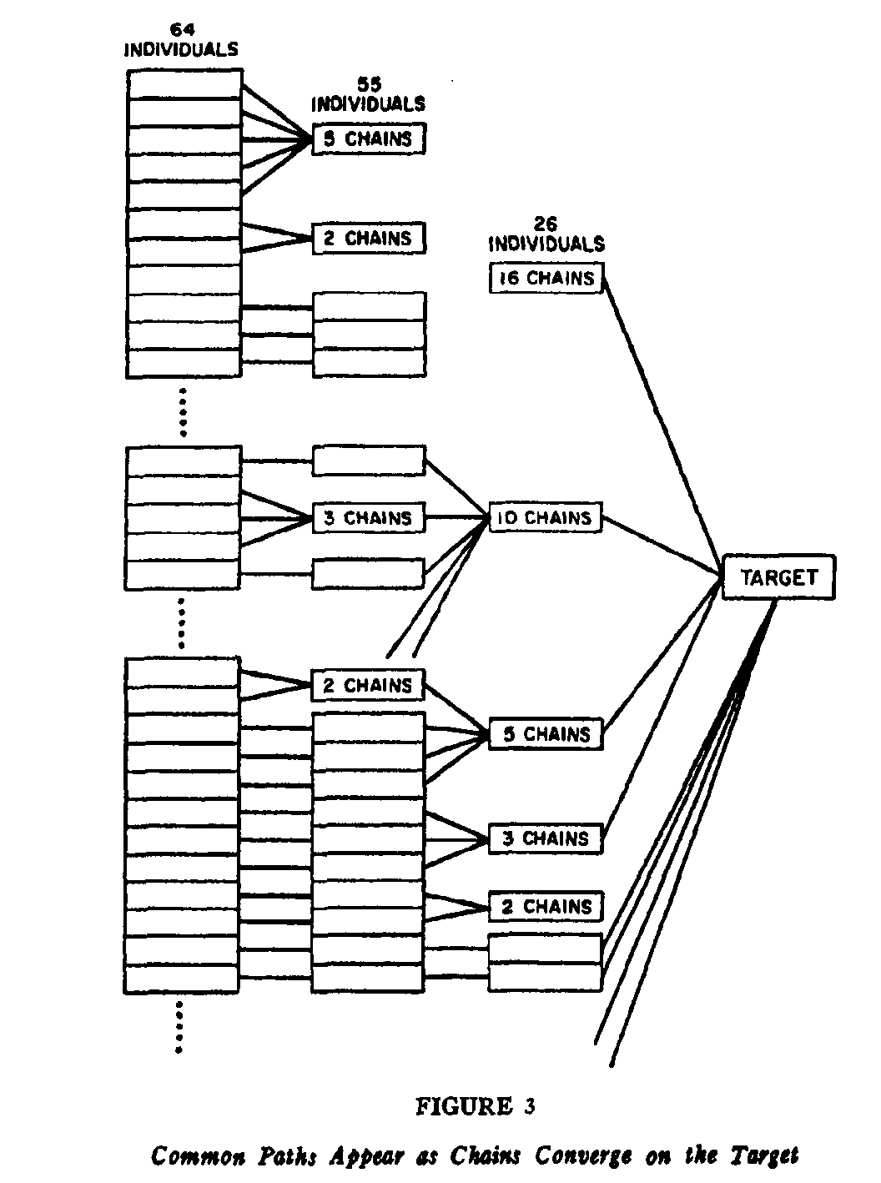
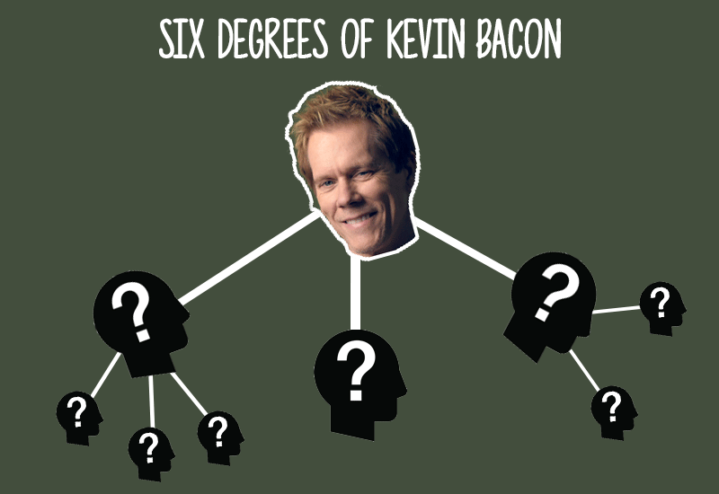
Connectivity & Cohesion: Clustering
‘Small World’ phenomenon:
What’s the probability two nodes are connected?
Milgram’s packet experiment – 6 step average
Notes:
More commonly known in social network settings:

Slide 63
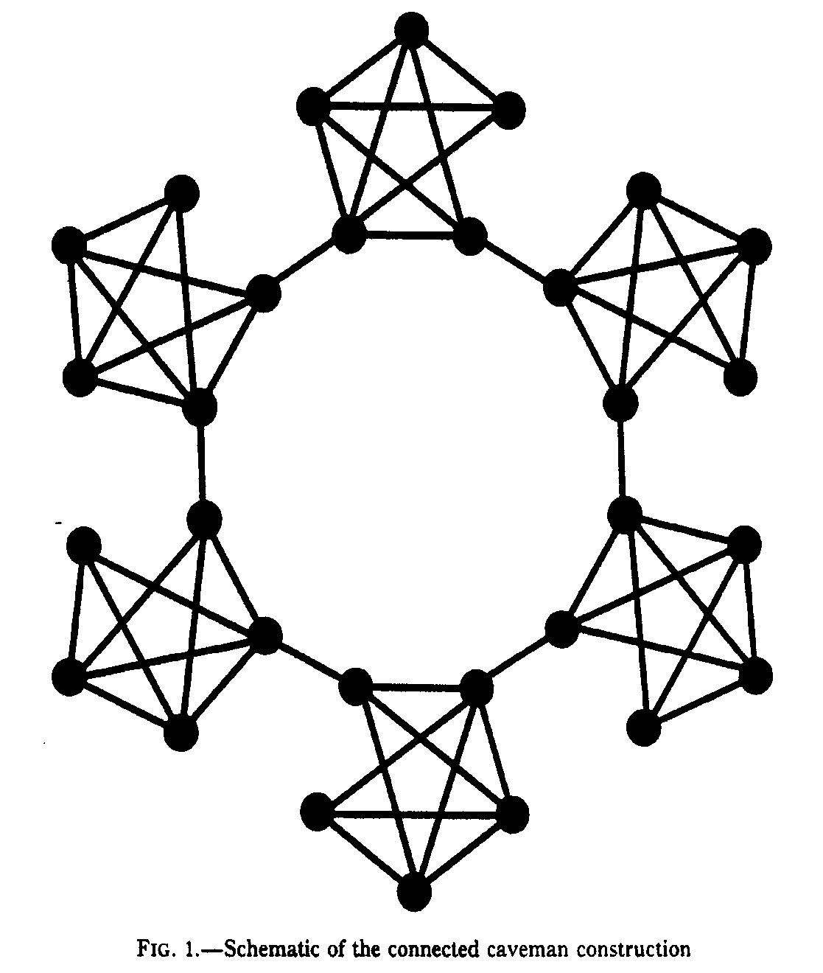
Connectivity & Cohesion: Clustering
Small world graphs: generally large, sparse, decentralized, highly clustered
Watts – small local changes can have big effects on the global network – a ‘small world graph’ has relatively small average path lengths and relative large clusters
Notes:
Watt’s “caveman’ world of clustered groups; easy to imagine, co-workers, old friends, family; generally: large, sparse, decentralized, highly clustered networks

Slide 64
Connectivity & Cohesion: Clustering
Small world graphs:
‘shortcuts’ between clusters dramatically reduce average path length
Can dramatically affect capacity for disease transmission, or other network features
Notes:
Watt’s “caveman’ world of clustered groups; easy to imagine, co-workers, old friends, family; generally: large, sparse, decentralized, highly clustered networks

Slide 65
Connectivity & Cohesion: Clustering
How else can we measure the ‘small wordliness’ or other cohesive characteristics of a network?
Clustering coefficient:
Average local density (ego-network density/n)
Transitivity ratio - # closed triads/total # triads
Verdery et al. 2017 – comparing two RDS networks of persons who inject drugs in Philippines, see higher clustering associated with higher and faster spread of HIV/AIDS
Notes:
Small taste of much broader literature, because in larger social network data, calculating clustering gets complicated

Slide 66
Connectivity & Cohesion: Structural Cohesion
Structural Cohesion – extent to which networks or sub-groups within networks are ‘sticky’, interconnected, or resistant to disruption
Challenging to measure
Connectedness maintained through one or a few actors
More paths linking network that don’t rely on one actor = more cohesive
Notes:
Thinking about patterns of network connections and clusters leads to cohesion

Slide 67
Connectivity & Cohesion: Structural Cohesion
Reachability – actors i and j are reachable if any path in the network connects them; more paths linking (and re-linking actors in the group) increases the ability of the group to ‘hold together’
Pattern of ties, not just density
D = . 25
D = . 25
Notes:
Reachability also as an individual node centrality-esque measure;
See in graphs, same density, different reachability, different cohesion

Slide 68
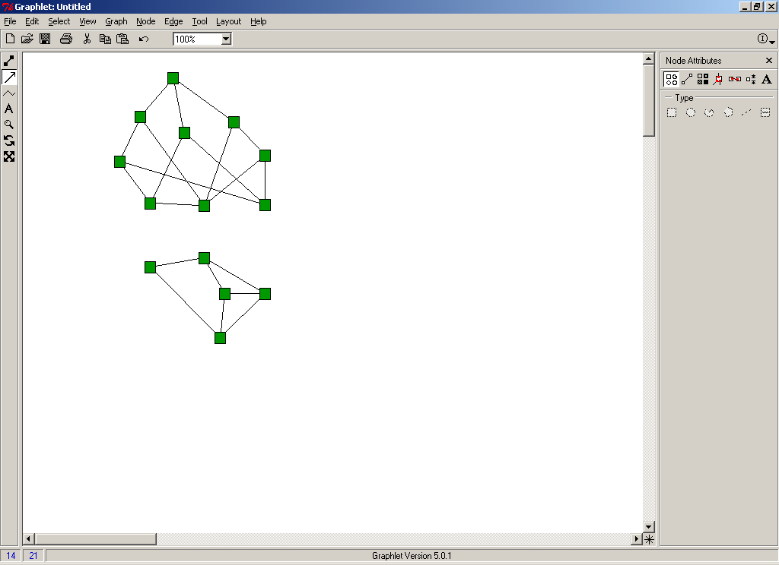
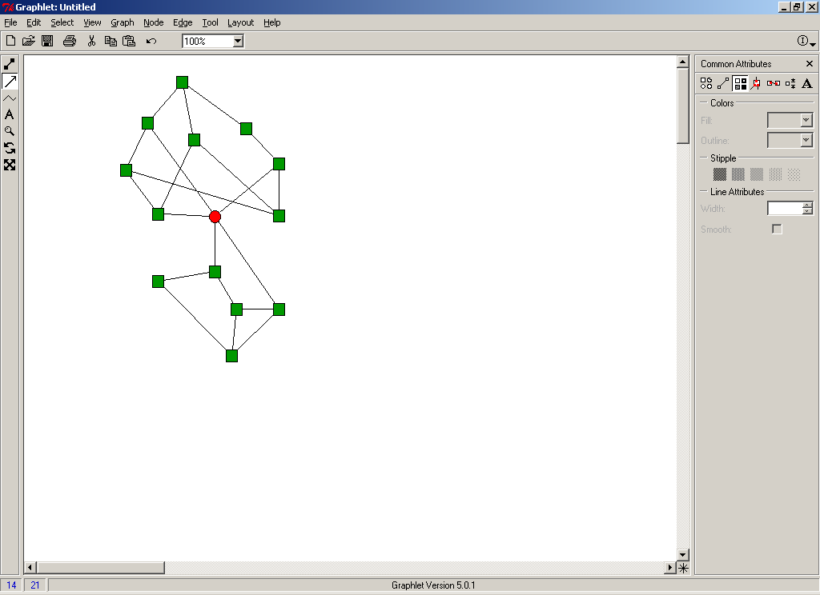
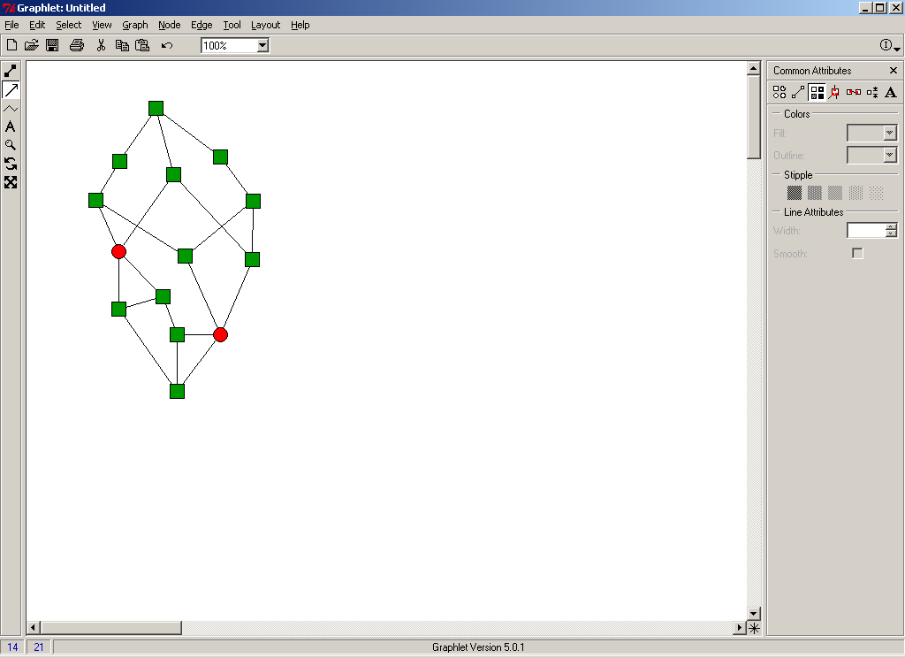
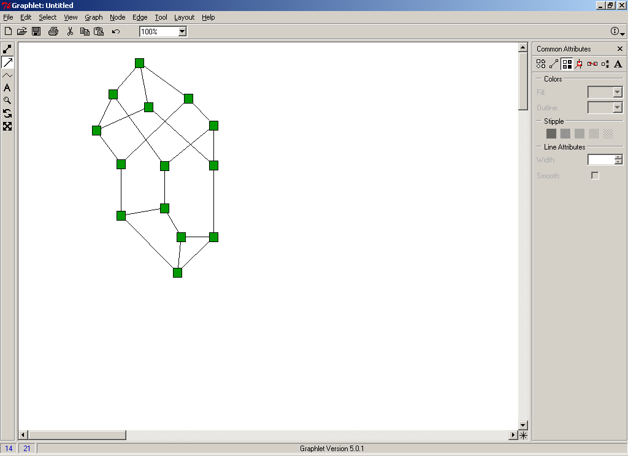
Connectivity & Cohesion: Structural Cohesion
Same volume of ties, but graph on right has more independent paths connecting network, making it more cohesive
0
1
2
3
Node Connectivity
Notes:
Same volume, but left to right, same density of ties, but with slight rewiring of edges: graphs become more difficult to separate & number of independent paths increases, so on far right, can trace at least 3 completely independent paths between every pair of people in the net; more cohesion a network that doesn’t rely on one or two actors for staying connected
Like with triads: can imagine how this explodes computationally in a real-world network with more nodes and non-random connections reflecting social processes
Health implications: imagine how this shapes ability to transmit disease, for ex, but fair to say don’t see as many direct applications in nets & health lit as with traditional centrality measures or measures like density/centralization/clustering, partly because of many complicated ways of conceptualizing & computing this in ‘real’, messy network data, also because might be more useful to examine vulnerable/useful actors with centrality, or characterize specific mechanisms generating network, like transitive clusters

Slide 69
Connectivity & Cohesion: Components
Component – maximal connected sub-graph - connected graph where there is a path between every node
Cut-point – node whose removal would disconnect the graph
Cut-set – set of nodes necessary for keeping graph connected
2
1
4
3
5
7
6
8
Notes:
Strong and weak components: weak ignores directionality

Slide 70
Connectivity & Cohesion: Components
Formally defining structural cohesion:
Minimum number of actors, who if removed, would disconnect the group
Minimum number of independent paths linking each pair of actors in the group
2
1
4
3
5
7
6
8

Slide 71
“Add Health” Example: Cutpoints
Notes:
(Cardinal sin of not setting seed for examples, so viz is slightly re-organized here)
Cutpoints in blue – see mostly that would disconnect those ‘pendants’ only connected by one tie, but a few more central cutpts in center (remember, high betweenness)

Slide 72
Connectivity & Cohesion: Components
Features of components:
k-components – maximal subset of actors linked by at least k node-independent paths
Every member must have at least k ties (but having k ties doesn’t necessarily make a component)
2 k-components can only overlap by k-1 members (or would be same component)
Can be nested
Can also consider components for ego-networks
Notes:
Thinking about features of components can help to indicate robustness of connectivity & cohesion in the network; E.g. often see bi-components used as measurement of a decently connected group; bicomponent as graph with 2 independent paths linking actors

Slide 73
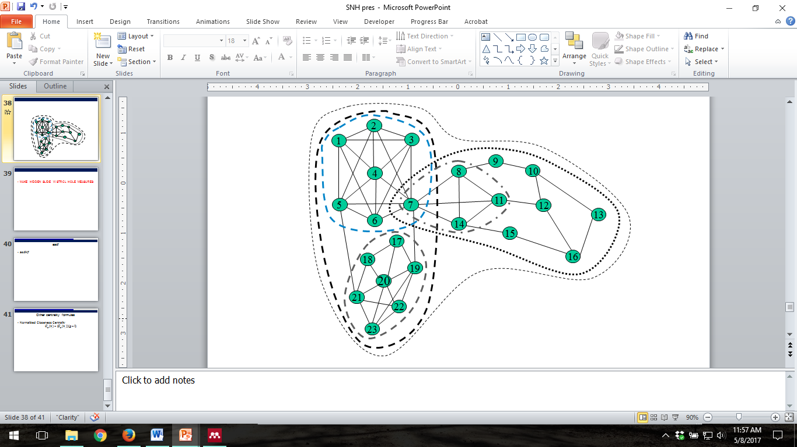
Connectivity & Cohesion: Components
Embeddedness – identify cohesive groups (blocks) in a network, then remove k-cutsets identify successively deeper embedded groups in graph
Moody & White 2003
Notes:
See person #20 – embedded in local group, then connections on left side of net, then whole net; can describe levels of nestedness seen in net or for indvl nodes

Slide 74
Connectivity & Cohesion: Groups
Different types of sub-structures in networks:
Cliques – all members connected to all other members
n-clique – where n is number of steps greater than direct tie, so can consider 2-clique, defined by 2-step (friend of a friend) ties
k-plex – every member to connected to at least n-k others in the graph (relaxed from connected to all but self, n-1, of the clique)
Mostly intractable in large networks
Notes:
Clique pretty strong, different relaxations of that definition; note not that commonly used because difficult to calculate in large networks and v strict, but often use term colloquially

Slide 75
Connectivity & Cohesion: Groups
Different types of sub-structures in networks:
n-clans – members connected at distance n or less, only through other members
k-cores – members joined to at least k other members, even if not connected to all other members
Notes:
K-core: see have 1, 2, 3, so groups connected by one, 2, or 3 ties to other alters
Can visualize just the 3-core; connected to at least 3 others in group

Slide 76
Overview
Centrality
Connectivity & Cohesion
Roles
Structural Equivalence
Regular Equivalence

Slide 77
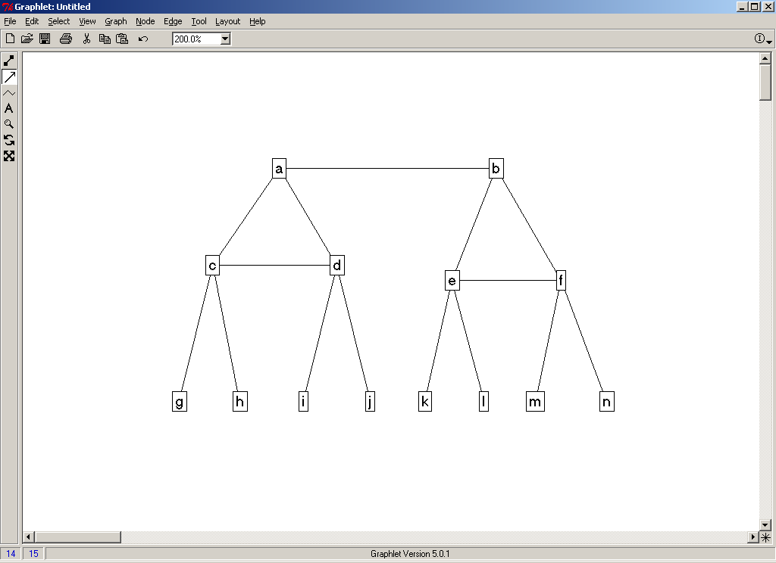
Roles & Positions: Overall
Measures that describe subsets of actors/nodes who have similarly structured relations
Might expect different risks or behaviors for actors occupying similar positions or roles
Notes:
Examples of roles: Boss, managers, employees (right), nuclear family (left)

Slide 78
Roles & Positions: Structural Equivalence
Structural Equivalence:
Actors are equivalent if they have the same ties to the exact same people in the network
Rare, maybe more restrictive than you want for thinking about roles and positions in a network, so can relax to:
Regular Equivalence:
Actors are equivalent if have ties to same types (but not necessarily the exact same) of alters
Notes:
Conceptually: most general, “untapped” way to characterize multiple-relation networks (like describing kinship relationships, where (in US/English, at least) ‘cousin’ is ‘cousin’ whether mother’s brother’s child or father’s sister’s child)

Slide 80
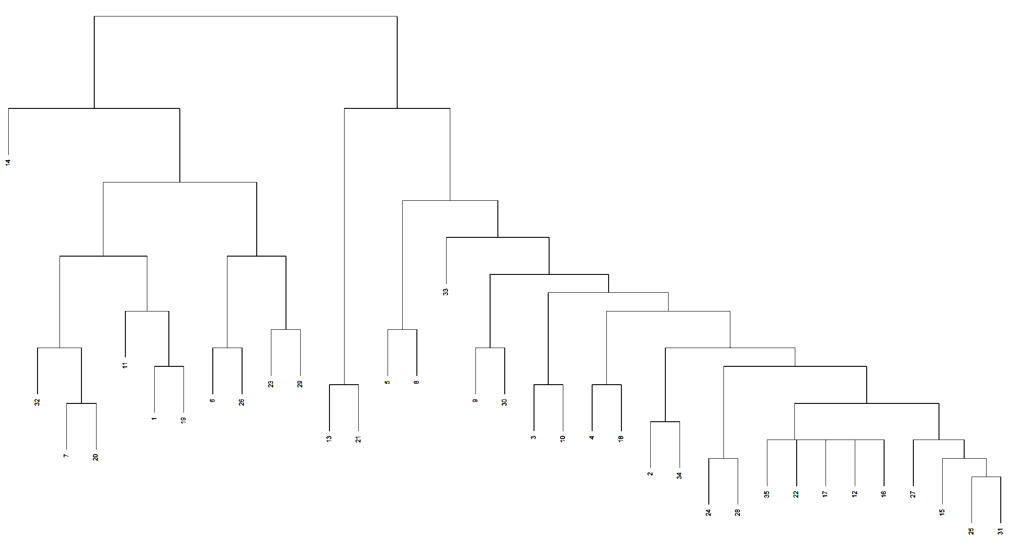
Notes:
Complicated Structural Equivalence dendrogram with our small toy network, but see some equivalent positions might not otherwise notice eye-balling it

Slide 81
Roles & Positions: Structural Equivalence & Blockmodeling
Blockmodeling – process of identifying similar positions (groups of similar actors in a ‘block’ of the adjacency matrix)
Based on attributes
Based on patterns of ties
Can be increasingly generalized and abstracted
Ex: Core/periphery
1
2
3
Notes:
Blockmodel – finding groups of similar positions -- if blockmodel adj matrix of this example net according to reqular equivalence (could do any other attribute), get 3 positions, 2 with loops (within position)

Slide 82
Roles & Positions: Structural Equivalence
Structural (Regular) Equivalence: Actors are equivalent if have ties to same types (but not necessarily the exact same) of alters
Fujimoto & Valente 2012: Exposure to substance use through structural equivalence is a better predictor of drinking and smoking, (being connected to the same types of peers with the same types of behaviors matters more than traditional measures of cohesion)

Slide 83
Describing Networks: Summary
Many ways of describing networks or characterizing nodes of interest within them
Here: individual node properties, entire network counterparts, then structures and sub-groups:
Centrality
Connectivity & Cohesion
Roles
Frame as micro/meso/macro
Micro: individual nodes
Meso: sub-groups, sub-graph structures, roles
Macro: features of entire networks

Slide 84
Describing Networks: Summary
Not considered here:
Dynamics – churn or stability over time, effects of changes, etc.
2-mode networks
Many more challenging concepts and additions in describing networks:
Centrality or structural measures specific to certain topics or processes
Groups & Community Detection

Slide 85
Thank you!
Questions?
molly.copeland@duke.edu

Slide 86
Resources
Cornwell, B. (2009). Good health and the bridging of structural holes. Social Networks, 31(1): 92-103.
Ennett, S. T., Bauman, K. E., Hussong, A., Faris, R., Foshee, V. A., Cai, L., & DuRant, R. (2006). The Peer Context of Adolescent Substance Use: Findings from Social Network Analysis. Journal of Research on Adolescence, 16(2), 159–186.
Fujimoto, K., & Valente, T. W. (2012). Social network influences on adolescent substance use: Disentangling structural equivalence from cohesion. Social Science and Medicine, 74(12), 1952–1960.
Guan, W., & Kamo, Y. (2016). Contextualizing Depressive Contagion: A Multilevel Network Approach. Society and Mental Health, 6(2), 129–145. http://doi.org/10.1177/2156869315619657
Hawe P, Webster C, Shiell A. A glossary of terms for navigating the field of social network analysis. Journal of Epidemiology & Community Health 2004;58:971-975.
Kornienko, O., Clemans, K. H., Out, D., & Granger, D. A. (2013). Friendship network position and salivary cortisol levels. Social Neuroscience, 8(4), 385–96.
Jasny, L. Descriptive Measures for Social Network Analysis, Advanced Networks II seminar slides, ICPSR 2016.
Landon, B. E., Keating, N. L., Barnett, M. L., Onnela, J.-P., Paul, S., O’Malley, A. J., … Christakis, N. A. (2012). Variation in Patient-Sharing Networks of Physicians Across the United States. JAMA: The Journal of the American Medical Association, 308(3), 265.
Luke, D. A. & J. K. Harris. Network Analysis in Public Health: History, Methods, and Applications. 2007. Annual Review of Public Health. 28:69-93.
Moody, J. Slides from Social Networks Seminar, Duke, Spring 2015.
Moody, J., & White, D., (2003). Structural Cohesion and Embeddedness: A Hierarchical Concept of Social Groups. American Sociological Review, 68: 103-127.
Morris, M., & Kretzschmar, M. (1995). Concurrent partnerships and transmission dynamics in networks. Social Networks, 17(3–4), 299–318
O’Malley, A. J. & P. V. Marsden Health Serv Outcomes Res Methodol. 2008 Dec 1; 8(4): 222–269.
Scott, J. Social Network Analysis. 2012. SAGE.
Scott, J. & P. J. Carrington. The SAGE Handbook of Social Network Analysis. 2011.
Valente, T. Social Networks and Health. 2010. Oxford University Press
Verdery, A. M., Siripong, N., & Pence, B. W. (2017). Social network clustering and the spread of hiv/aids among persons who inject drugs in 2 cities in the philippines. JAIDS Journal of Acquired Immune Deficiency Syndromes, 76(1), 26-32.
Wasserman, S. & K. Faust. Social Network Analysis: Methods and Applications,. 1994 Cambridge.

